Slide 1
Conflict Checking Using the O&A (Ordinary and Amorial)
Juliana de Luna
VKWHSS 2025

Slide 2
Thinking about conflict
What’s conflict and why do we care?
Most designs don’t have a conflict

Slide 3
The Rules – One Big Change (SC) – Changes to the Field
Plain field vs. a divided field
Divided field with substantially different direction: Per pale vs. Per fess vs. per chevron
But not per pale vs. paly
Quarterly, per saltire, per pall, per pall inverted, gyronny, checky, party of six are all different from everything else
When in doubt (at all) – go look at SENA A.5.F

Slide 4
The Rules: One Big Change (SC) to primary charge
Adding or removing a primary charge group
Change of the type of every charge in the primary charge group
Change of the number of charges in the primary charge group: 1, 2, 3, many
Change of arrangement of the primary charge group: in fess, in pale, in cross…
Change of posture of the primary charge group: rampant, passant, fesswise, palewise…
Details in SENA A.5.E

Slide 5
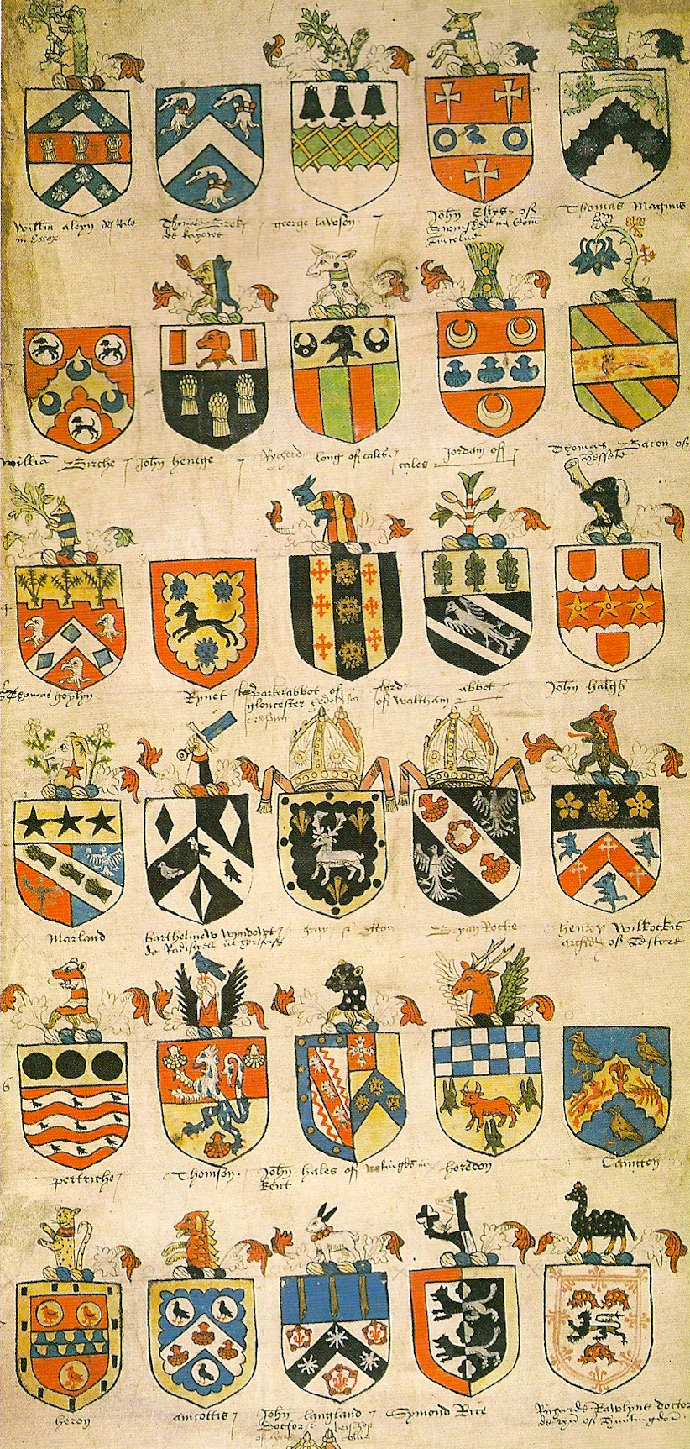
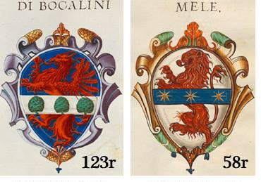
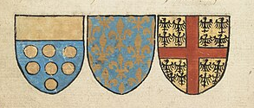
But what’s the primary charge group?
Can’t overlie another charge – must be directly on the field
If there’s a central ordinary, then that
Otherwise, whatever charge or group of charges is central
Semy can be primary
Peripheral ordinaries can’t be primary
This is all in Appendix I of SENA

Slide 6
What’s the primary charge?

Slide 7
What’s the primary charge?

Slide 8
More kinds of charge groups – and how they work for conflict
Secondary: around primary charges, there can be multiple
  If there’s only one, compare them
  If there are more than one, compare the “types” – peripheral ordinaries, strewn or counted charges on the field, etc.
Overall: overlie other charges, there can be only one
Tertiary: charges on charges, there can be multiple
  Only compare them if they’re on a charge group you’re comparing (primary, secondary, overall)

Slide 9
Back to the primary charge
Armory with the same primary charge (or one that’s not a DC away from it) are the only designs that can conflict
So once we start looking, we’re only looking in one – or at most a few – categories
Gules, a lion Or does not conflict with Gules, a horse Or or Gules, a mullet Or

Slide 10
Strategies for looking at the O&A
Unless you know otherwise, assume that everything that’s a potential conflict is in the same “charge” category
Some charges are separated by tincture, posture, and whether they’re charged
Start with the exact match – same tincture of primary charge group, same tincture of field
Don’t waste time figuring out what birds, crosses, or type of tree conflict
  Assume that things in the same category conflict until you find a possible conflict
  Then ask the specific question, like Do roosters and cranes conflict?

Slide 11
Comparing Blazons
I count DC’s (or SC’s) as I go
When I’ve hit two DC’s or one SC, I’m done and can move on to the next blazon
YES, that means I don’t read most of them

Slide 12
So what are we looking for – what makes a DC
Field: change to tincture, direction of lines, number of pieces, or style of line (plain, wavy, etc.)
Fieldless armory gets one DC against all other arms (including fieldless ones)
Adding or removing a charge group
Changing the tincture of at least half of a charge group
Changing the way the tinctures of a charge group is divided gives DCs just changes to the field

Slide 13
More DCs
Change of type/category of at least half the charge group, including adding, removing, or changing complex lines
Change of number: 1, 2, 3, 4, 5, many
Change of arrangement – if the change is not forced
Change of posture and orientation – but only if they’re comparable
  So, Gules, a pale between three lions rampant Or isn’t clear of
  Gules, a pale between three eagles displayed Or and
  Gules, a pale between three axes fesswise

Slide 14
So now let’s put it to work
Submitter wants Azure, a chevron argent between three increscents Or
Where do we look?
What’s the primary charge?
Which category do we start with?
Where do we start within that category?

Slide 15
Now let’s try it with some real submissions!

