Slide 1
Naming Practices of Italian Academies
1442 - 1600

Slide 2
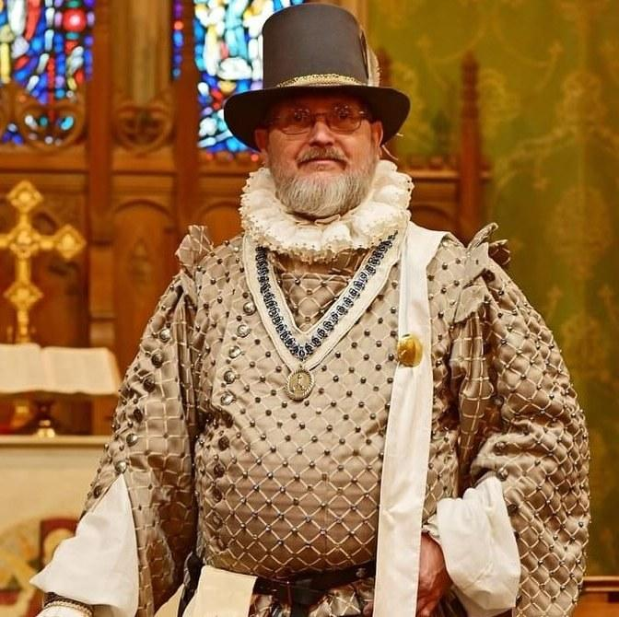
Instructor
Maestro Avenel Kellough, OD, Caid
Notes:
Hi, I’m Maestro Avenel of Caid. I’m not regularly a research herald. This class stems from identifying a gap in our knowledge. It is both to help myself register a name for my group of students, and make it easier for others to register names of Italian academies,

Slide 3

Problem: Lack of Information
Notes:
After my Elevation to the order of Defense, I wanted to have a collective name for my students.
I went to my local names research herald, and told her I wanted Italian. Her comment was "Italian is hard".
This didn't seem right. So I went looking, and found only one small article on the subject.

Slide 4
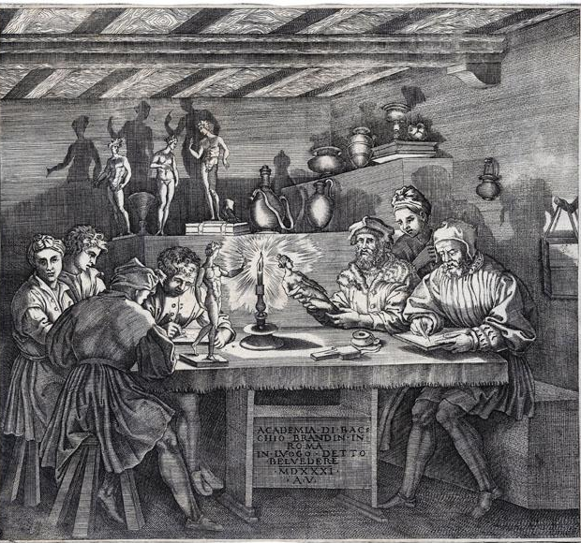
What were the Italian Academies?
Notes:
Academies were voluntary associations of individuals. They first appear in the mid 15th century. They may have a focus; art, music, military training, religion, Etc. They are often small and ephemeral, but some became large, with branches in multiple countries.
Closest analogue to SCA households I’ve found in period.

Slide 5



Italian Academies Database
Notes:
I found a database of 587 Italian Academies (1525-1700) at the British Library. The original was funded by the United Kingdom's Arts and Humanities Research Council (AHRC), in conjunction with the Royal Holloway University of London. It was published in 2017.
The data is formatted as XML records, a format I wasn’t able to access. Many thanks to Master Dubhghall MacÉibhearáird of Drachenwald for turning it into a google spreadsheet that i could access and manipulate.

Slide 6

What does the database contain?
Notes:
At the British Library site, There are two sets of XML records. The first is the project records, which are separated into three sections: academies, people, and works. The section on academies is the area I delved into. The people section has records on 7100 people, which is probably a gold mine for Italian name research. The works section is the works sited by the project to gather the data.
The second is the images database. It has over 1000 images, including academy emblems, portraits, and works title pages.

Slide 7
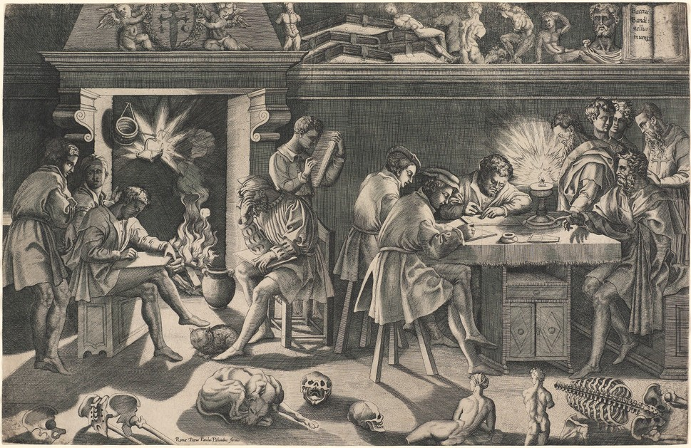
Relevant Data
Notes:
For my purposes, I extracted all the academies definitely documented to have been created in 1600 or earlier. I have a table of 114 academies with certain dates before 1601, and another of 65 with less certain dates, but dated before 1601.
For the first chart, I’ve done my best to translate the names into English, and catagorize them by type.

Slide 8
Examples
By Attribute
  Accademia degli Intronati (Academy of the Enthroned)
  Accademia dei Dispersi (Academy of the Missing)
  Accademia degli Affumati (Academy of the Smoked)
By Location
  Accademia del Viridario (Academy of the Garden)
  Accademia degli Eubolei (Academy of the Euboleans)
  Accademia delle Notti Vaticane (Academy of the Vatican Nights)
Notes:
By far the most common type is by attribute. They can be aspirational, like the Enthroned. Some are ironic, like the Missing. And I suspect some, like the smoked, were in jokes shared by the members, whose reference is now lost.
By location is also very common. Often a city, like Venice or Ferrara, it could also be a local landmark, such as the Parthenon, or a well known garden.
Combining an attribute with a location is very common. For example, the Accademia degli Oziosi-Bologna (Academy of the Idle of Bologna).

Slide 9
Further Examples
By Person
  Accademia Pontaniana (Pontano’s Academy)
  Accademia di Tullia d`Aragona (Academy of Tullia of Aragon)
By Profession
  Accademia dei Vignaiuoli (Academy of the Winemakers)
  Accademia degli uomini d`arme (Academy of the Men at Arms)
By Religious Figure
  Accademia di San Pietro (Academy of Saint Peter)
  Accademia dei Tergemini (Academy of the Trinity)
Notes:
Reasonably common is naming the academy after a particular person. Accademia Pontaniana was one of the earliest, named after poet Giovanni Pontano.
Tullia of Aragon ran one of the documented academies founded by a woman. She was a courtesan, a poet, and prolific writer.

Slide 10
Outliers
Astronomical (1 example)
  Accademia della Stella (Academy of the Star}
After one particular play (3 examples)
  Accademia Partenia
Objects (2 examples)
  Accademia dei Puavoli -Compagnia della Calza (Academy of the Puppets Stock Company)
Notes:
Some categories had few representatives.
There were three separate academies named after one particular play. That was Partenia, by Barbara Torelli Benedetti. First published in 1586, it is a pastoral play, and a rare surviving example of a play written by a woman of that time. It must have had quite an impact to have 3 academies in 3 cities named for it.
Several early 16th century academies are also stock companies. Stock companies are theater troupes.

Slide 11
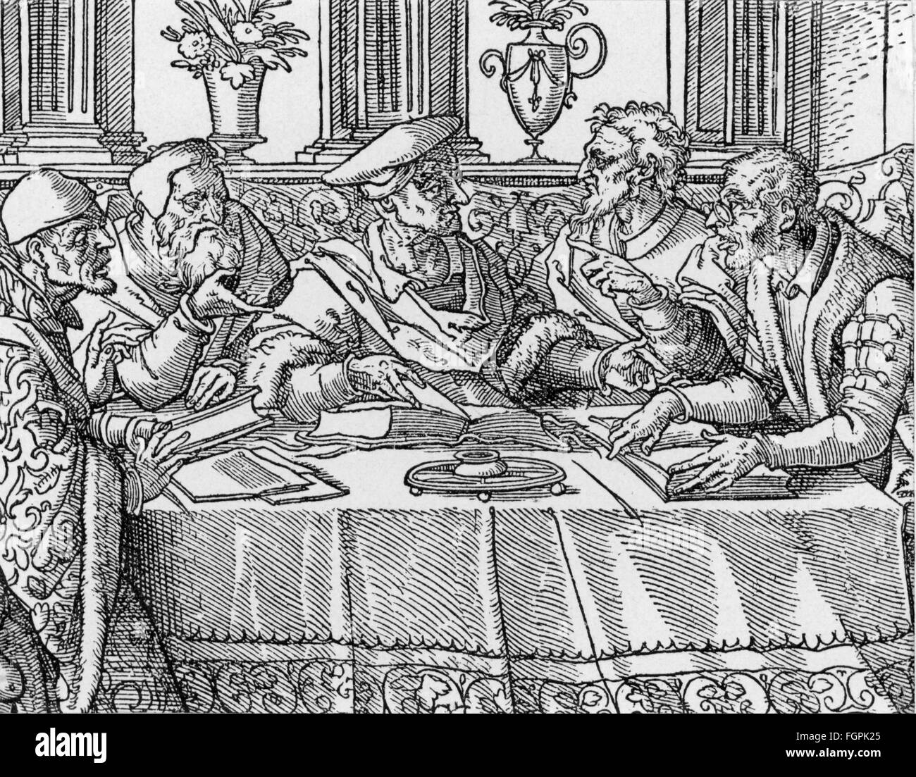
Conclusion
Notes:
So to conclude: adding the list of names for Italian academies in period expands possibilities for household names.

Slide 12
Bibliography
Everson, Jane. "The Italian Academies 1525-1700: The First Intellectual Networks
of Early Modern Europe." UK Research and Innovation, 1 Jan. 2018,
gtr.ukri.org/projects?ref=AH%2FH023631%2F1#/tabOverview. Accessed
24 Jan. 2025.
Gianfrancesco, Lorenza. "Italian Academies." British Library Shared Research
Repository, 7 Oct. 2021,
bl.iro.bl.uk/collections/f7312873-9014-40b7-9e7f-2e65bc5f49b0?locale=en%29.
Accessed 24 Jan. 2025.

