Slide 1





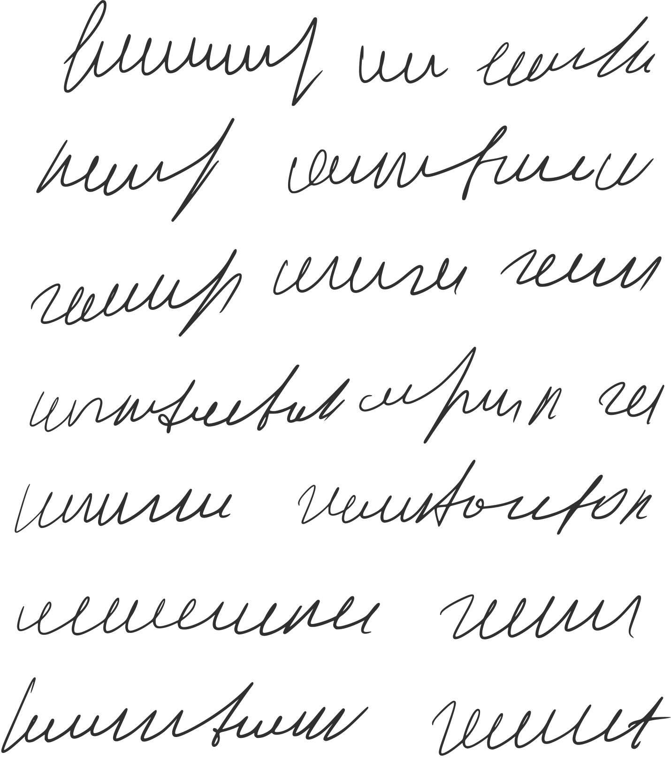









SCA Armorials and You:
An Introduction and Best Practices
Meister Dietrich von Sachsen, OP

Slide 2
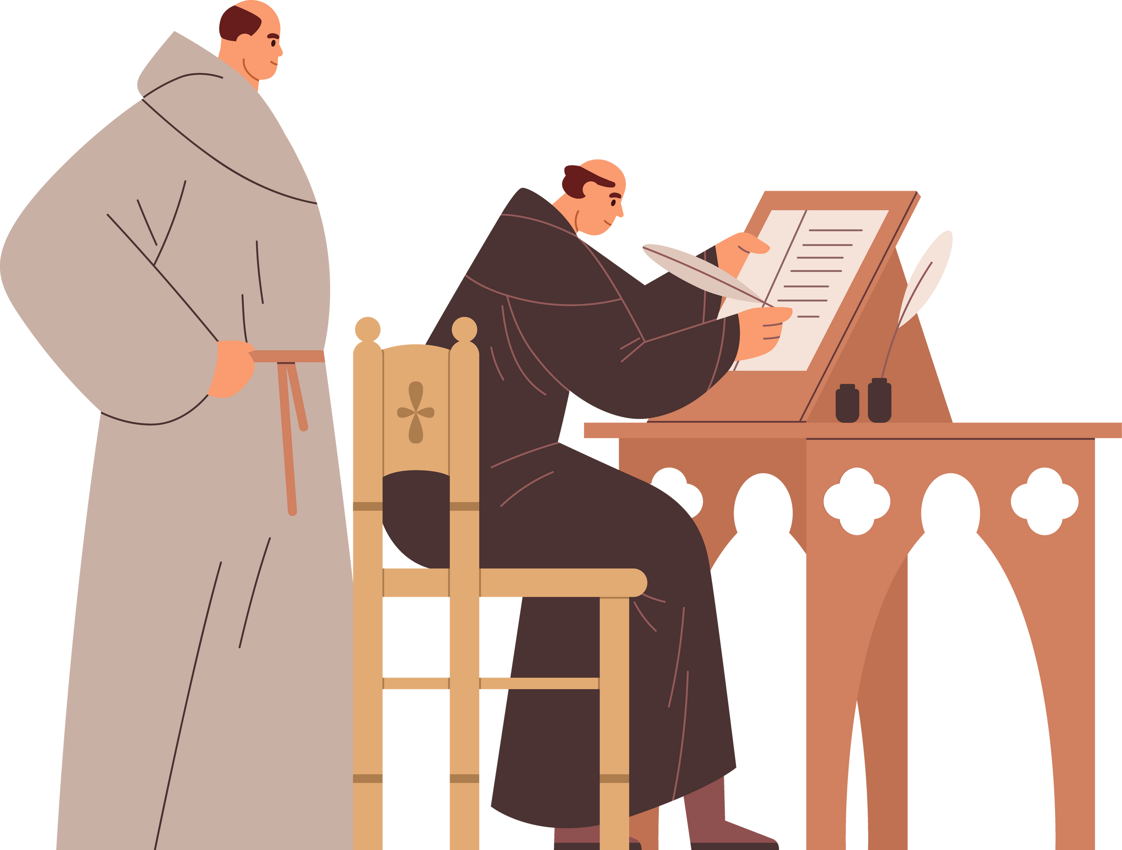


Overview of the Class
A brief description of period armorials and how they were used
From the earliest armourials of the 13th century right down to the first printed armourial in 1605 CE.
Questions to ask yourself when creating a digital roll of arms
Before you embark on creating a digital roll of arms, several questions will need to be answered about scope. Exactly who’s arms are going to be included?
Tools and techniques for making a roll of arms
From artistic tools to research techniques, these should hopefully make your process easier.

Slide 3
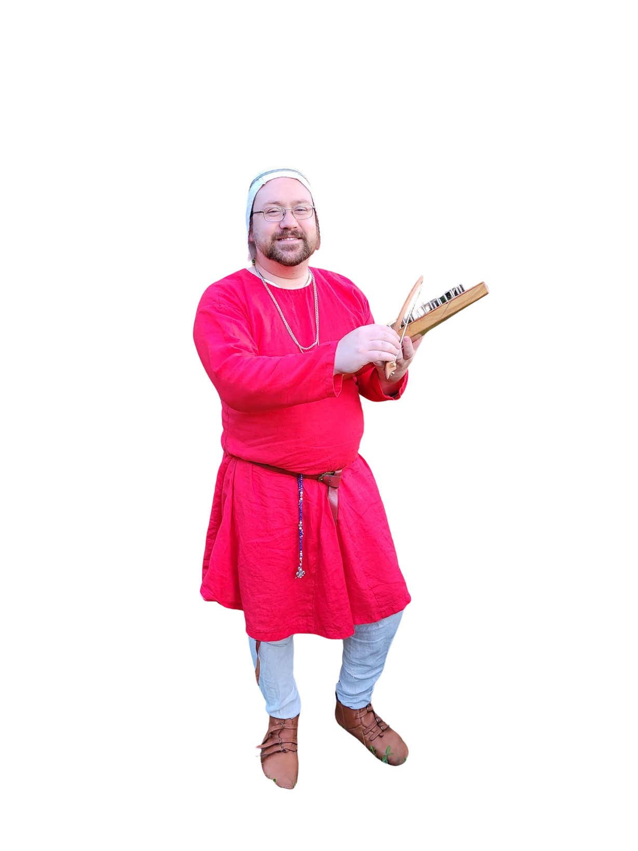

Who is this person, anways?
Meister Dietrich von Sachsen, OP
Edelherz Herald Extraordinary, as well as Red Escutcheon Pursuivant (In charge of Ealdormere’s armoury education and deputy to Buccina Herald)
I produce a good chunk of the digital art used in both Ealdormere’s heraldic letters and the College Imaginary’s April 1st LoI.
My current Ealdormerian Roll of Arms, including group badges and branch heraldry, counts 1,263 unique pieces of armoury, as well as a smattering of use arms and out-of-kingdom pieces.

Slide 4




Rolls of Arms in Medieval Europe
A roll of arms, also called an armourial, is a collection of blazons usually (but not always!) accompanied by an image of the emblazon. Effectively, these are heraldry encyclopedias!
(They’re also really great research sources!)
The earliest rolls of arms appear in the mid-13th century, and go on right through the end of the SCA’s period.
How a roll of arms was compiled varied wildly. Examples include:
  Occasional (participants in a tournament, attendees of a coronation)
  Institutional (members of an chivalric order)
  Regional
  Illustrative (in the context of a given chronicle or narrative)

Slide 5

Your Digital Roll of Arms: Determine Scope
A digital roll of arms is a great resource for scribes, webministers, and others. However, before you start, you will need to determine not only the scope of your armorial, but who’s armoury qualifies.
For example, if you’re putting together a regional armorial, consider the following:
  What region? (Shire/Canton, Barony, Principality, Kingdom)?
  Who counts as being part of the region? What about those who used to participate in your region but has since moved away or stopped playing?
  Do you include unregistered “use” arms? What about non-period styles or elements?
  Does everyone use the same escutcheon shape, or do we vary the forms of display?
  Devices and Badges, or just Devices?
  Naming conventions - registered names only, names used in the SCA, or some combination of the two?

Slide 6
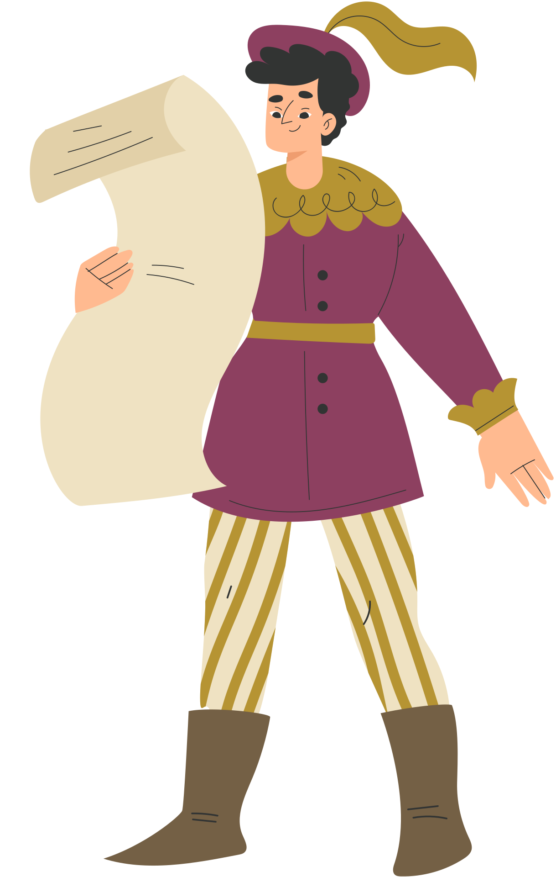
Tools and Techniques: Getting a list of blazons
Getting a List from the O and A
Use the “Date/Kingdom Search Form” to get a list of all registrations in your Kingdom. This does get a bit fuzzy when finding people who were playing before your kingdom was created....
Your Kingdom has an OP – use it!
By cross-referencing your Kingdom’s Order of Precedence (OP), you can search for either full names or name elements to see if that person has a registered name and armoury. Helpful for pre-Kingdom registrations!
Contact the Archivist
If you’re not understanding a blazon, or it’s something very wierd/can’t be done under our current rules, contact the archivst to get a copy of the emblazon!
archivist@heraldry.sca.org

Slide 7
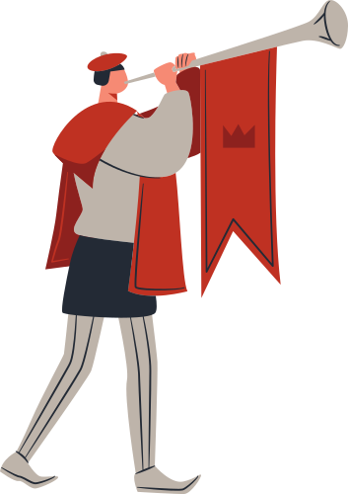
Tools and Techniques: Making emblazons
Have a consistent template or templates
Having a consistent template for various forms of display - escutcheons, lozenges, roundels, etc. - will help visually unify your armourial. The same applies with tinctures, though in rare cases you may find you need to adjust those to make the best looking emblazon.
Photoshop (or similar program) is your friend
Any program that have layers and can allow you to cleanly adjust the size of an image will make this process so much easier.
Sources for artwork
  Traceable Art Project
  Mistholme
  Heraldry Clip Art packages
  Wappenwiki
  OSCAR
  SCA Archivist
  Google
  Avoid JPEGs whenever possible

Slide 8



Tools and Techniques: Making emblazons

Slide 9


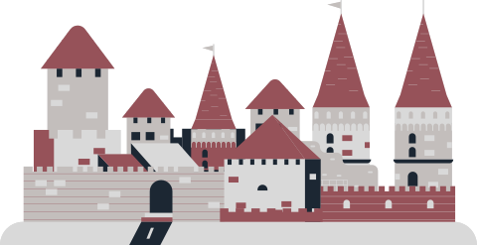
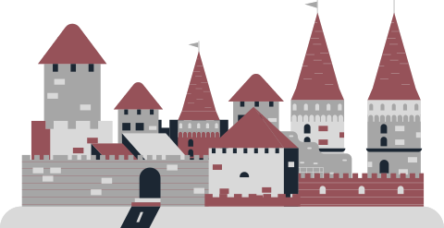
Go forth and emblazon!
Thank you for joining me in this overview of creating SCA armourials.
Questions?

