Slide 1
Scripting SCA Peerage Ceremonies
Magistra Nika Dmitrieva doch’ Zvezdina

Slide 2
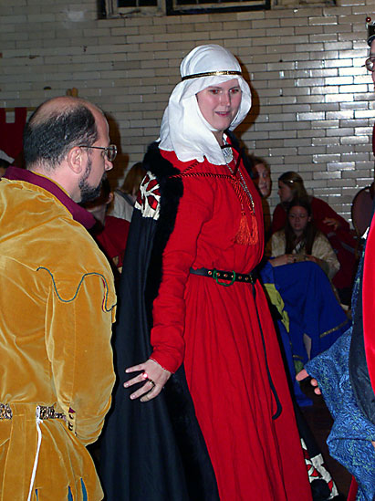
What we’ll cover
What is a peerage ceremony?
A word about interkingdom anthropology
What happens in a peerage ceremony?
First principles of ceremony scripting (and what could possibly go wrong?)
Questions to ask first
Sources
Drafting and blocking the ceremony
What to do on the day of?

Slide 3
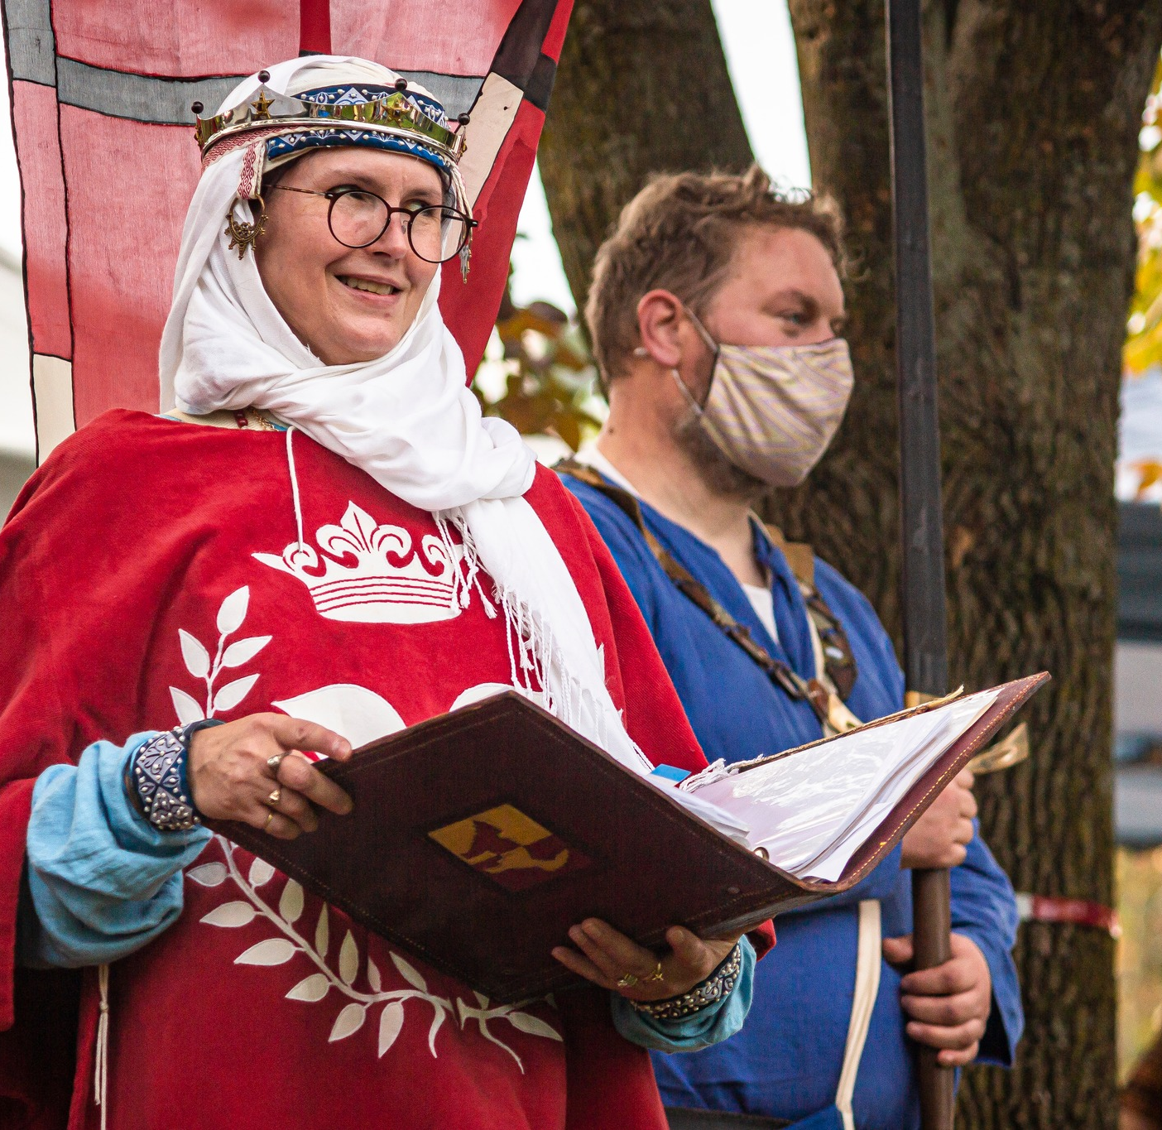

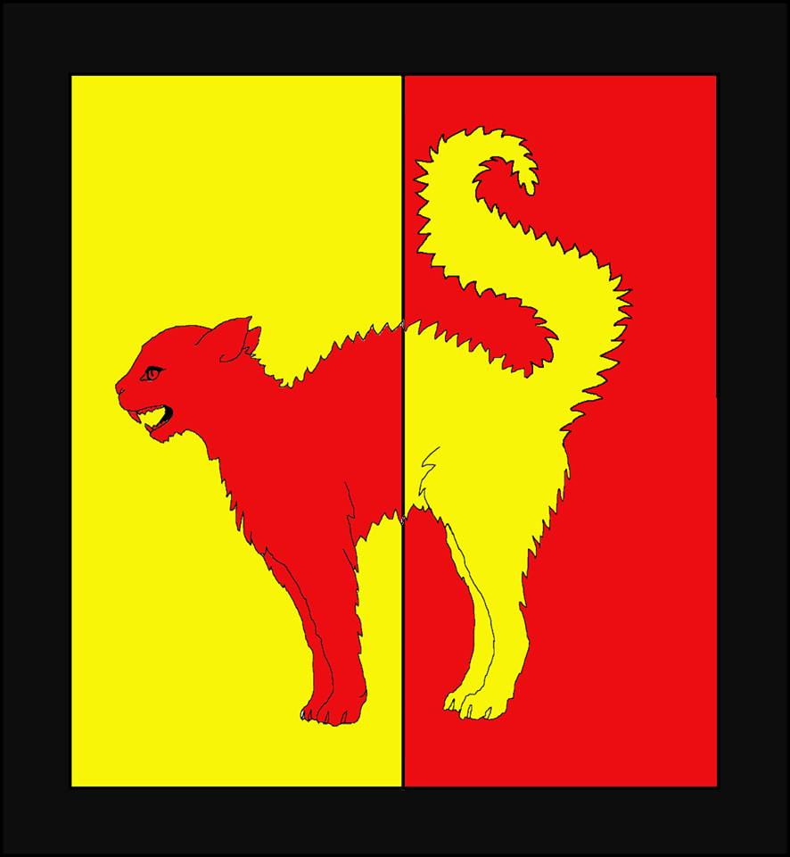
About me
Magistra Nika Dmitrieva doch’ Zvezdina, OP, OL, Rouge Estoile HE
herissonycat@gmail.com

Slide 4
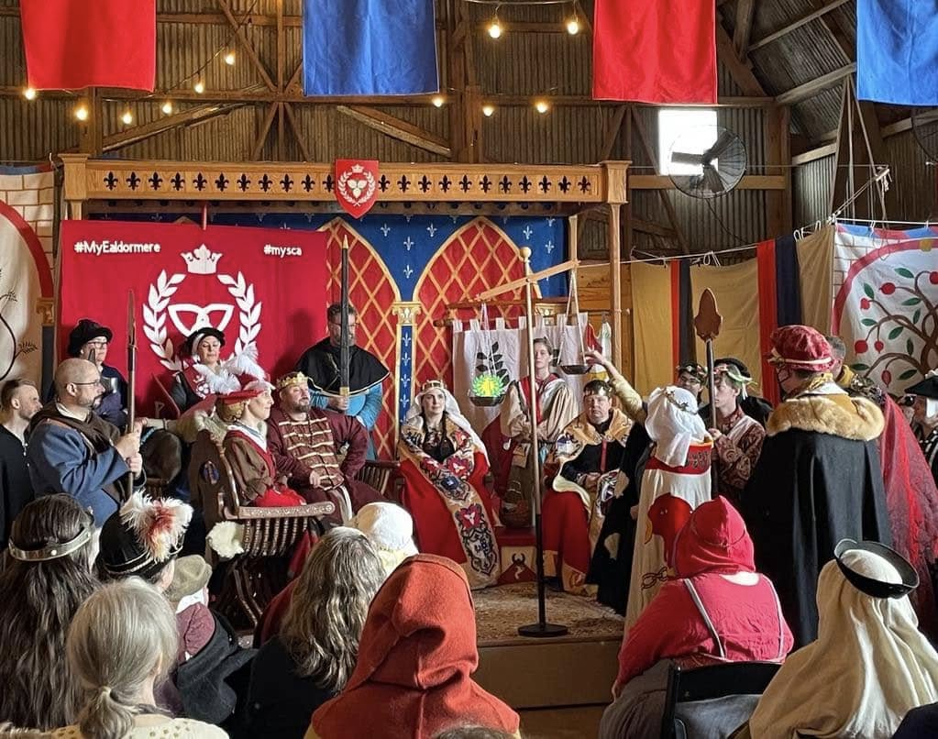
What is a peerage ceremony?
Ceremony to elevate an SCA member to one of the bestowed peerages
Original model: historical knighting ceremonies
SCA evolution

Slide 5
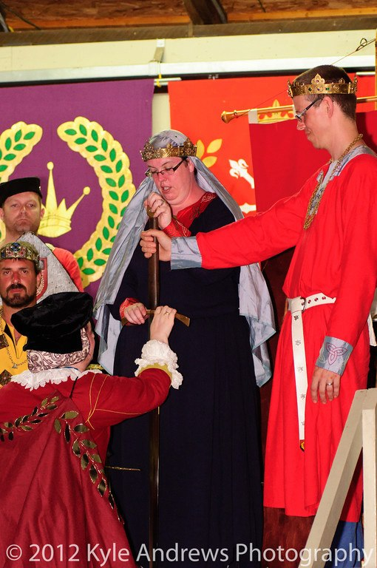
A word about interkingdom anthropology
Most kingdoms have “default” ceremonies
Some kingdoms have strong traditions
Other kingdoms lean towards customization
You must understand these customs first

Slide 6
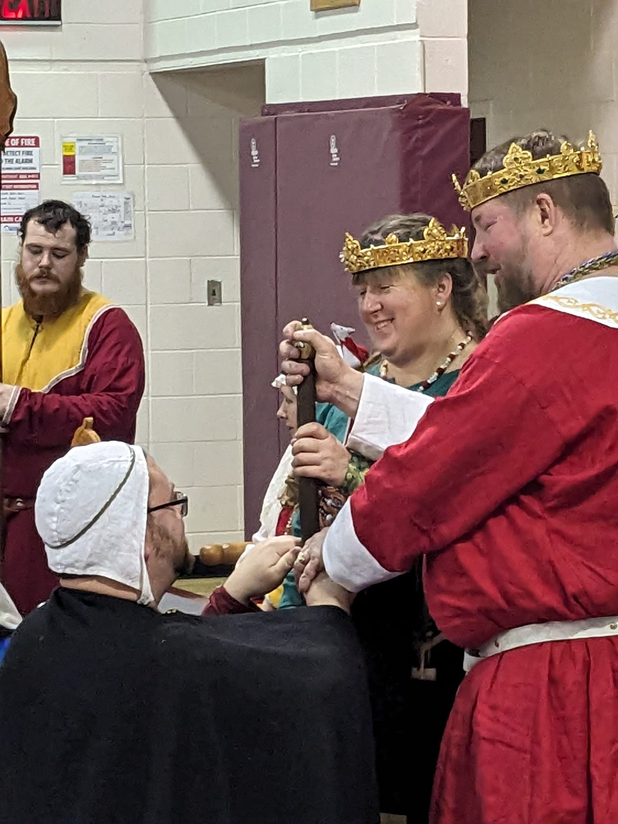
What happens in a peerage ceremony?
Begging or restating boon
Asking the question of the Order
Calling the candidate
Attestations of worthiness
Dissolving of former bonds
Oaths or promises
Elevation and bestowal of regalia
Fealty, if applicable
Official record of status
Proclamation and presentation to the populace
Notes:
The person who originally begged the boon (or a stand-in, if for some reason that person is unavailable) will restate the boon. (This is sometimes omitted, particularly if it has already been done multiple times)
The Order will be called in and asked whether the candidate is acceptable
The candidate will be called in.
Usually, various people will attest to the peerlike qualities of the person. More on that in a moment.
If the candidate is in a dependent relationship, that relationship may be publicly ended at this point. (Sometimes this is done privately).
The candidate will make oaths or promises—usually including giving counsel to the crown, training of dependents, and continuing to increase their labours. Other promises may be included that are specific to the Order.
The Crown will elevate the candidate and bestow regalia. For Knights, this normally includes belt, hereditary Ealdormere chain, spurs, and sometimes a sword. For Masters, the baldric and sword is bestowed. For Laurels, a medallion, the hereditary Ealdormere ring, and other regalia (cloak, hood, Laurel wreath) are presented. For Pelicans, the hereditary Ealdormere medallion and other regalia (cloak, hood, cap of maintenance) are presented. For the Masters of Defense, the hereditary collar, knotted cord, and other regalia (sword, garter, cloak, etc.) are presented.
If the new Peer is a knight, he/she will do homage and swear fealty. If a Pelican, Laurel or Defense, he/she may choose to swear fealty.
The scroll (if present) is read.
The new Peer is greeted by the members of the Order.

Slide 7
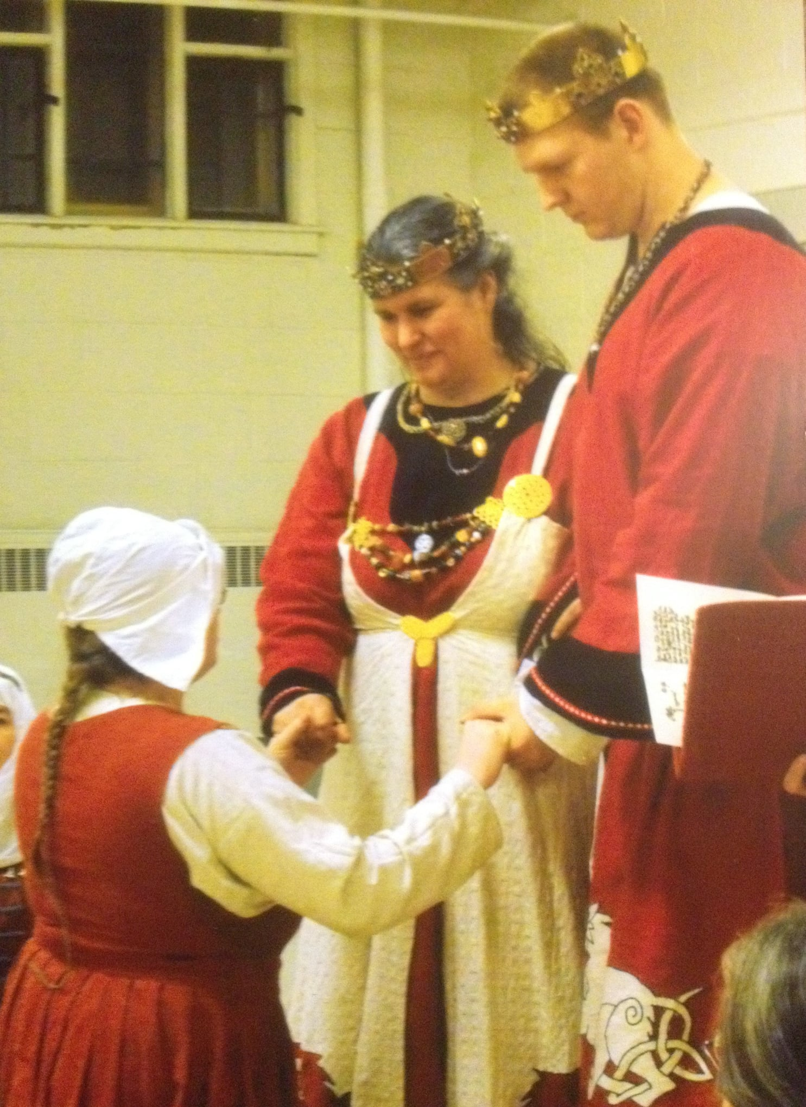
First principles (and what could possibly go wrong?)
Duty to the Society
Duty to the Crown
Duty to the Kingdom
Duty to the candidate
Notes:
Peerages are Society-level awards. The ceremony should reflect this
The ceremony should be acceptable to the Royalty. (In other words, they need to see it beforehand, so that they know what they will be doing and saying and what to expect). Peerage elevations are often a highlight of the reign, and Their Majesties will want the elevation to reflect well on them and Ealdormere as a whole. They will also usually care about making it meaningful to the candidate.
You also have a duty to the Kingdom—not just in terms of traditions, but because they are your audience. A ceremony that no one can hear or that is overly long, unsuited to a particular site, full of too many in-jokes, or containing huge blocks of esoteric text will have your audience talking for months about the ceremony—and not in a good way (examples)
The ceremony should be meaningful to the candidate. He/she is your client.
Always offer or wait to be asked. “I’ll write your ceremony!” is not the first thing a new vigilant should hear

Slide 8
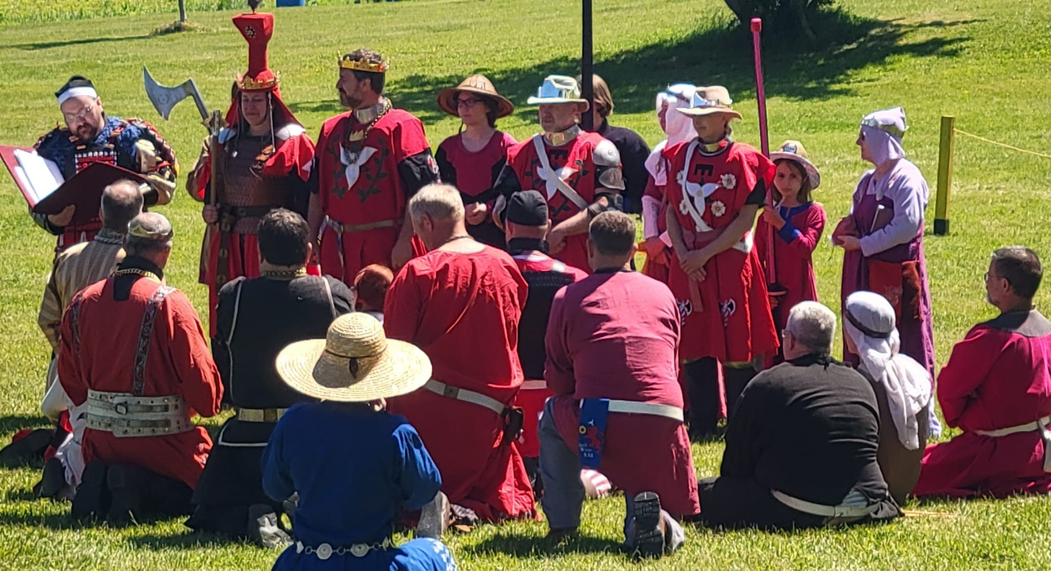
Ceremony writing checklist
Is there a prescribed ceremony?
What does the candidate want?
What is most important to the candidate?
Has someone done this before?
Will the scroll text relate to the ceremony?
Are the Royalty on board?
Notes:
Is there a prescribed ceremony? If so, what can be customized?
Does the candidate want a low-fuss or standard ceremony? This is the most important first question to ask. Some folks do not want fancy, or do not like to be the centre of attention. In these cases, simply making sure the basic ceremony is tweaked to meet the person’s needs is all that needs to happen.
If the candidate wants a custom ceremony, what is most important? Authenticity in the ceremony itself? Incorporating friends or family? A particular culture? Music? Concepts or ideals (e.g. virtues and vices)? Take note of the requirements, and then start looking for information to help flesh out these ideas. Talk to other people with similar interests. What can be found using your Google-Fu?
Has anyone else (or you) done a similar ceremony before? Can that ceremony be adapted?
Will the scroll text be designed as part of the ceremony?
Are the Royalty on board with what you want to do? How far ahead of time do they need the ceremony text?

Slide 9
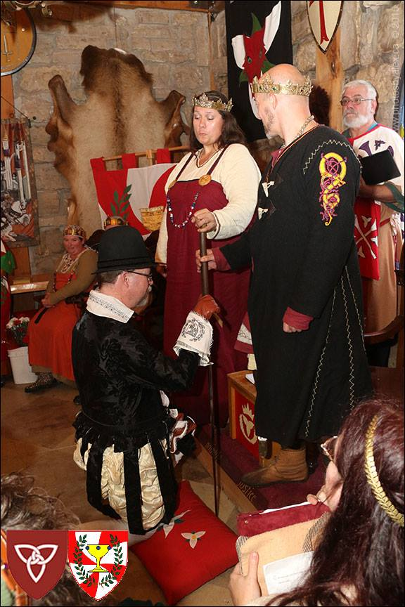
Sources
Extant period ceremonies
Period laws, rules and regulations pertaining to rank
Descriptions of oaths
Descriptions of court ranks or dignitaries
Literary references
Cultural references
Other ceremonies for a particular culture
Notes:
One of the challenging parts of creating a peerage ceremony is that aside for a few descriptions of elevation to late period chivalric Orders, we do not have any extant period ceremonies to draw upon as models. So when someone says “I want a 13th century English Laurel ceremony,” what this has to mean, from a scripting standpoint, that someone wants a ceremony that would be in keeping with that culture and time period, and possibly with what the person is being recognized for. How were leaders or nobility recognized within that particular era and culture? What can we draw from history or literature or legal documents or even artwork that may help us give the ceremony flavor? Were there guilds or other groups that recognized mastery? Were there court positions for poets? How would a warleader or trusted advisor be recognized? Are there other ceremonies or rituals for that culture that might lend flavor? In some of these cases, we may not have a ceremony, but we may have an idea of oaths that were sworn.

Slide 10
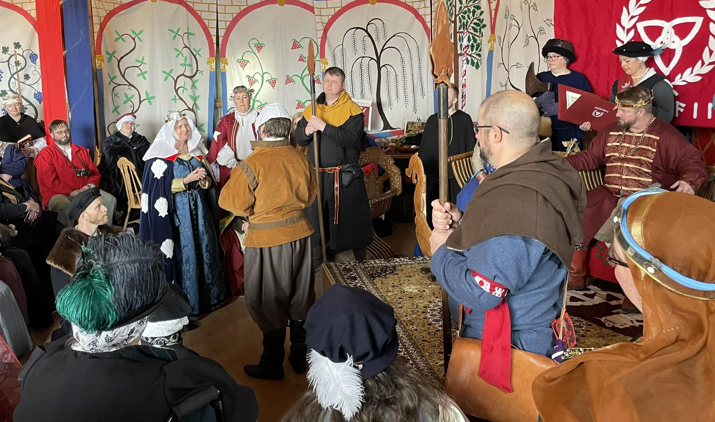
Drafting and blocking the ceremony
Start with the basic structure and build
Who will the speakers be?
How much speaking do the Royalty want to do?
Don’t over-script
Elevation oath or promise; fealty
Regalia
Scroll
Blocking
Rehearsal
Notes:
Lay out the basic structure of the ceremony, as mentioned at the beginning of this article. Then begin inserting the various elements.
Who will the speakers be? How many? How will you call them or frame this section? Getting the speakers on board with the ceremony is often the forgotten step, and speakers will turn a ceremony from words to reality. Generally avoid having them speak pre-written material; give that to the herald to introduce or frame the speakers.
Large or difficult blocks of words are best given to the herald or another person to read. Make sure you keep what the Royalty say short, and preferably not involving foreign languages they do not speak.
If you put in a release of a candidate by the Peer, do not script this. It will happen as it happens.
Generally, the Crown then states their intent to elevate and asks for an oath or promise. What will the oath be like? What does the candidate want to promise to do? Is it important that it be a promise (rather than an oath)? Does the candidate want to swear on “relics” or something else (such as a book or the medallion of the order, etc.)? This oath is not normally done on the Sword of State. Always make sure to clear the oath with the candidate before the ceremony. He/she needs to know what is being promised. Does the candidate want/need to swear fealty? Make sure the proper oath is part of the ceremony.
What kind of regalia will be bestowed? How will this be done? Who will have it, and what are their cues? Who will have the Ealdormere legacy items, and when will those be presented?
Can you get the scroll text ahead of time? (It’s particularly effective if the text and the ceremony support each other).
This is theatre! Treat it accordingly! You are scripting a dramatic presentation. How will the audience be involved? How will you make sure they can see and hear the ceremony? Will this ceremony take place indoors or outdoors? How much space to you have? Is there an elevated stage? Will there be sufficient space in the front for the Order? What needs to be added to the ceremony regarding stage directions? What items are needed, and who will have them? Is a centre aisle required? Are chairs required? Will musicians play processional music, and what is their cue? If the candidate is processing, what is their cue to form up? What are the cues for the speakers? How long can the ceremony be? How long should it be?
You may not have time for a full rehearsal, but ideally, unless this is a very basic ceremony, doing a read through with the roleplayers (or stand-ins) to catch any missing bits is helpful.

Slide 11
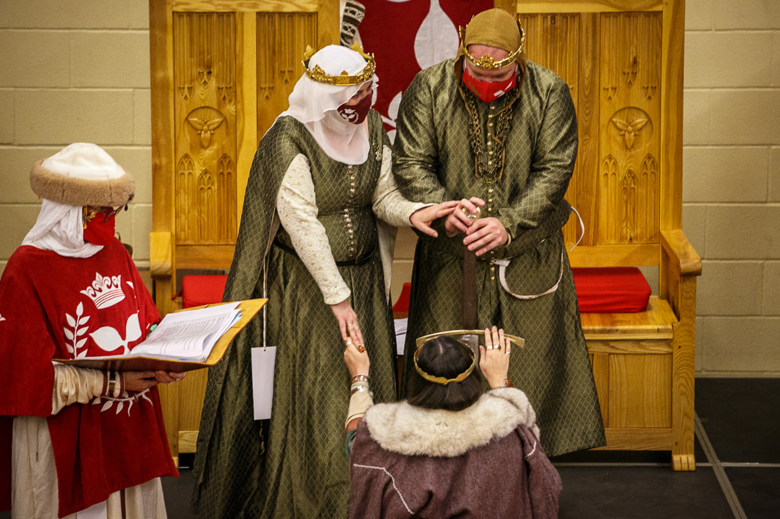
On the day of the ceremony
Check in with the candidate
Check in with the speakers and other roleplayers
Check in with the Royalty and/or their herald
Check with bringers of stuff (e.g. regalia, scroll)
Check in to make sure there are no last-minute changes

Slide 12
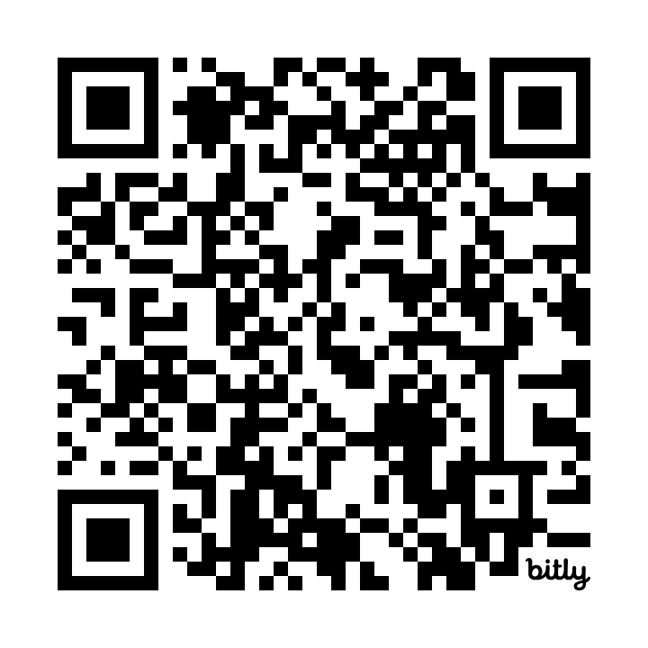
Visit my ceremony archives
https://bit.ly/Nikas_Ceremony_Archives
Please keep this slide for attribution

